Slide 1

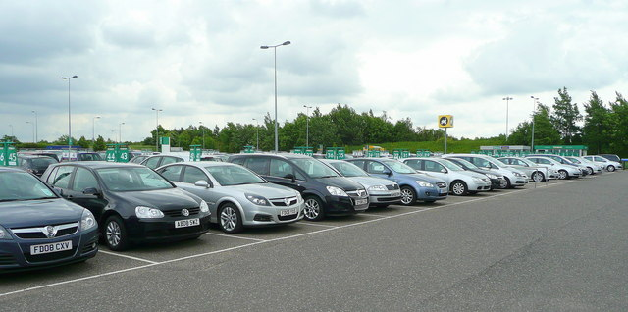

Car Rental System
By:
Varun Ladha [17CE049]
Kalpit Machhi [17CE051]
GUIDED BY:
Professor Khushboo Patel
Professor Padmavati

Slide 2
Problem analysed…..
We found that car renting firms at low level are keeping there customer record manually as they cannot afford costly softwares available in market.
The customer is getting confused while selecting the car and is sometime also cheated as they don’t have proper knowledge about cars.

Slide 3
Aim
To ease the renting of car for customer as well as owner.
To keep a record of customers for a car renting business and to ease the explanation part of salesman

Slide 4
Concepts used of Object oriented programming.
CLASSES AND OBJECTS
OWN MANIPULATORS
CONTROL STRUCTURES
INHERITANCE
OWN HEADER FILE
CONSOLE I/O MANAGEMENT
FILE HANDLING WITH CSV FILES
Functions

Slide 5
FUNCTIONALITIES OF PROJECT
It shows the cars which are available in the rent house.
It shows the details of the selected car and gives the customer to go back to main menu and see other cars details and have a better review of the cars available.
It makes the tedious task of managing customer data
Easy and access to it faster using customers mobile
number.
It helps the owner to calculate bill.

Slide 6
DIFICULLTIES FACED BY US
Any project has three faces analyzing problem, solving problem ,making suitable algorithm and code of solution.
We were facing problem in making a suitable algorithm of the solution created by us .
Searching the thing required in csv file and the format of storing in csv file.

Slide 7
FLOW OF PROGRAM
WELCOME TO CAR RENTAL PROGRAM
2
1.BOOK
2.RETURN
3.EXIT
3
EXIT
1
WILL TAKE MO. NO AND CHECK FOR CUSTOMER
CAR SELCTION
NO
YES
BILL GENERATED
YOU BECOME CUSTOMER

Slide 8
1. Mahindra scorpio 2. Suzuki ertiga 3. Vitara brezza 4. hyundai creta 5. … 6. … 7. …
[A] SUV Cars

Slide 9
4. Hyundai Creta
-Average - Type [Petrol/diesel/cng] - Km driven - Engine power - Manufacturing year
-Seats
-Rate per kilometer

Slide 10
Have you selected this car ?? 'Yes' or 'no'
The User will be asked …

Slide 11
1.Enter name 2.enter mobile number. 3.enter advance to be paid.
If ‘YES’ …

Slide 12
- Enter 'MOIBLE NUMBER' and the detail of the car booked by the user having this number will be shown. - Final km will be noticed - Total = (f.km -i.km)*(rate/km) - Amount to pay = total - advance
2. Return Car

Slide 13
ADVANTAGES:
It will make the renting process more easy and customer favorable.
It will reduce the case of cheating with customer.
It will make the billing system easier.
DISADVANGES:
It will bring the job of salesman at risk.
Reliability of the information.

Slide 14
Thank you …
END

